Slide 1
Beth Israel Case Study
Ques 1. a) What are the types of analytics (descriptive, predictive & prescriptive) used in the project Risky States?
Risky States is a project undertaken by Beth Israel Deaconess Medical Center which involves using past data and making it available for nurses and doctors in order to improve patient care. It employs Descriptive and Predictive Analytics techniques in following manner:
Descriptive Analytics : Risky States project created a model using historical data it had compiled pertaining to ICU patients which is used for comparison with patients’ records as part of overall initiative to eliminate preventable harm.
Predictive Analytics : The model involved working with data scientists and Harvard researchers for data mining(predictive analytics) and creating decision trees to present risk levels and the factors that contribute to them.
Ques 1. b) What’s the specific problem that the analytics application Aptima is trying to solve?
Aptima has been working with Beth Israel Deaconess Medical Center on three projects to eliminate preventable harm in critical care. Aptima is trying to leverage the data available to them and using that to present the risk levels and the factors that causes these risk to caregivers and Clinicians on a user interface. By doing this, they hope to reduce the prevalence of risks by making changes in care. The first project is Risky States and the intensity index application. Second project is MyICU for ICU caregivers and families of patients in the ICU, and Content-Sensitive Checklist, an application that informs about patient’s current state in the ICU. All three projects have the same intention to help patients elimate the possibility of preventable harm.
Ques 1. c) What are the challenges (analytics, people& process) to solve the above problem?
There are a couple of challenges for Aptima in solving their problem.
Firstly, Analytics - The model has been designed only around dummy data and is based on historic data which is expected to be a good fit. When the application goes live, the model might not have been tested enough against real time data to account if it fits the model well.
Secondly, Process - The Analytics application which is expected to be handled by Aptima in future takes feed from different sources like EHRs, networked medical devices, HR systems etc. There is a lot of challenges around how the data is not normalized. It’s a tedious task to mine the data and normalize and structure it for analysis purposes.
Thirdly, People - It has been taken for granted that once the caregiver application goes Live, the staff is expected to query the application, and the application will calculate risk for the ICU or a particular patient. It has not been accounted for if the staff understands the interface and comprehends what the risk score signify and action expected from them.

Slide 2
Ques 1. d) How would you propose to overcome the above challenges?
For tackling Analytics problem – the complete historic data should be randomly broken down into modeling and testing samples. Modeling sampling should be used to build the model whereas testing data should only measure if the model is a good fit or not. This would provide clarity if our Live data will fit the model.
Process should also be standardized across different platforms. There should be data consistency and integrity across all systems by having centralization of data.
Users familiarity with the application should be considered. Staff should be given adequate training on how to use the application before it is made live.

Slide 3
Fantasy Football Guide
Product
Fantasy Football Guide(FFG) is a mobile application that will give you relevant information about your team players. It helps you decide which player to choose, their rankings, projections based on sophisticated analytic techniques applied on historic data.
A couple of decades ago, fantasy football was popular only among sports enthusiasts who had a passion for sports and keeping track of statistics. What started of as geeky hobby has grown into a pop-culture phenomenon. Thanks to high-speed internet it has participants completely absorb themselves in this game, creating their own team of NFL players who compete against other players by scoring points based on real-life stats of the NFL players on each team.
People want to follow team and player in real time, they look forward to accessing more and more meaningful statistics and recommendations from past seasons to make predictions on their player’s performance.
The target audience is mostly college educated men in their 30s-40s while other demographics groups stand strong as secondary targets.
Situation
Several apps have been trying to capture the market but failed to click with most fantasy football fans. Consumers often complain about :
Limited relevant information
People don’t want to pay
Poor navigation on the interface
Uncalled for tips/recommendations
Frequent app crashes
Incorrect predictions
Broken projected stats in critical championship games
Available data has missing attributes
Accounting for players frequently switching teams
Success rate of data modeling techniques
Funds associated with employing sophisticated techniques
Challenges
Proposed Solution
Develop an application that allows users to configure their line up, mock drafts to test things out and access latest scores and stats that will give NFL fans information that they are most interested in.
The application also intends to posts videos and news from our own team of distinguishes analysts.
Employing advanced data analysis methods to tackle problems with data inconsistency in order to improve overall efficiency of the application.

Slide 4
ASSUMPTIONS
Product is unique : It has been assumed that there are not many applications in market focusing on consumers feedback like Fantasy football Guide is doing. There are applications that are designed for similar objectives but not all are completely successful.
Market Potential : There is a significant customer base and a potential market that is interested in Fantasy League that is still untapped. When a particular product has failed to deliver, people are open to trying new products.
Data dependency : It is expected to have live feeds in the app during championship games, it has been assumed that the data is correct and has been validated enough to draw conclusions.
Funds : There will be sufficient availability of funds to carry out the business project.
Credibility of analysts: FFG will be posting videos and news from re-known sports analysts. It has been assumed that people would like to see the seasonal performances of players and insights of the subject matter expertise and will leverage that information in choosing their teams.
Pricing : Since people do not like to pay for these app services, it has been assumed that a trial period will be launched for the consumers so that most people can get a hands-on experience and start charging in subsequent months.
Profit margins : Based on the pricing and cost analysis and marketing/advertising schemes planned for the launch, it is expected that the product will incur profits.
Platform: Assuming all users will have accessibility to the same platform that the app is being built on.

Slide 5
ALTERNATIVE SOLUTIONS
Problem | Summary | Solution | Constraints
Data Inconsistencies | The NHL data available has information for decades covered for about 100 years. However, there is missing data for a couple of players because they might have either switched between multiple teams. Also it has been observed that teams have merged/split over the course of time and not much information has been shared in that regard. | One way to tackle this would be to request more information on data before analysis has been performed. Once we have background of a team, it will be more effective to design models around accurate data. | Lack of available information on team’s history.
Incorrect Predictions | Consumers often complained about how the predictions made were incorrect and were not aligned with how the players actually performed in game. This could be due to modeling techniques applied on the dataset. Failure to account for outliers and data anomalies might result in erroneous results. | Changing the approach to problem solving by dividing the dataset into two subsets and using one half to model the data and the other half to test the data against the model and producing multiple iterations to find the model that is best fit for the test data could help reduce inaccuracy levels in prediction algorithms. | Data quality checks must be applied before sampling and modeling the data.
Lack of Relevant Information | Consumers also complained about the get notifications and tips that thy do not want or don’t find useful. | People from varying background and knowledge are gaining interest in such application. Add features to customize the app according to users preferences. | For those who are new to fantasy league concepts would leverage tips/recommendations but not everyone appreciates the insights/tips provided by experts.

Slide 6
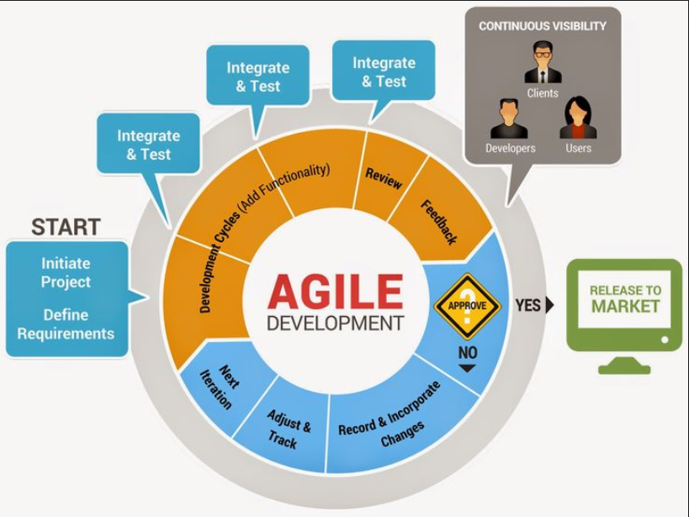
CHALLENGES IN PROJECT DELIVERY
Challenges with Data :
Data Cleansing : Normalizing data
Manual efforts in cleaning and manipulating data to feed into models.
Averaging out the missing information to maintain data inconsistencies.
Lack of availability of team’s history and if a player took time off.
Difficult Data Integration
Perform Data Quality Assessment
Create Data Visualization
Document source and meaning
Adhering to timelines
Adopting Agile Methodology will overcome most challenges by:
Prioritizing requirements based on risk since it’s not possible to test everything
It allows you to make changes, add new features and keep evolving with the
changing trends in fantasy leagues.
Since testing happens simultaneously hence projects can be launched sooner.
Customer satisfaction by continuous and rapid delivery of app modules.

Slide 7
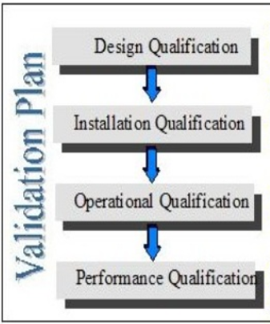
VALIDATION PLAN
Introduction
The validation plan can be started during the concept phase. However, the validation planning may be dependent on factors outside of your control like quality of data and data sourcing, market metrics etc. It may be performed in conjunction with the overall software development planning effort.
Purpose of the document :
This plan is used to assess software products throughout the software development lifecycle, ensuring that the software satisfies functional requirements.
Objectives :
Develop an app for fantasy football fans to help them form a desired team based on statistical analysis of given data.
Plan :
Collate data from various sources and normalize it to prepare it for analysis.
Perform continuous testing to validate correctness and consistency of data.
Identifying key review support milestones.
Adapt to changes
Apart from addressing the challenges, validation plan also includes :
Determine if the proposed concept satisfies the user’s needs and objectives. Functional & operational specifications are met.
Check arrival
Check for installation of hardware & software
Test of key operational functions
Check for specified application
Perform on-going performance testing

